Slide 1
L E C T U R E
12
Software Quality Assurance
Notes:
This repository of slides is intended to support the named chapter. The slide repository should be used as follows:
Copy the file to a unique name for your course and unit.
Edit the file by deleting those slides you don’t want to cover, editing other slides as appropriate to your course, and adding slides as desired.
Print the slides to produce transparency masters or print directly to film or present the slides using a computer image projector.
Each slide includes instructor notes. To view those notes in PowerPoint, click-left on the View Menu; then click left on Notes View sub-menu. You may need to scroll down to see the instructor notes.
The instructor notes are also available in hardcopy as the Instructor Guide to Accompany Systems Analysis and Design Methods, 5/ed.

Slide 2
STATISTICAL SOFTWARE QUALITY ASSURANCE
Statistical quality assurance reflects a growing trend throughout industry to become more quantitative about quality. For software, statistical quality assurance implies the following steps:
1. Information about software defects is collected and categorized.
2. An attempt is made to trace each defect to its underlying cause (e.g., non-conformance to specifications, design error, violation of standards, poor communication with the customer).
3. Using the Pareto principle (80 percent of the defects can be traced to 20 percent of all possible causes), isolate the 20 percent (the "vital few").
4. Once the vital few causes have been identified, move to correct the problems that have caused the defects.

Slide 3
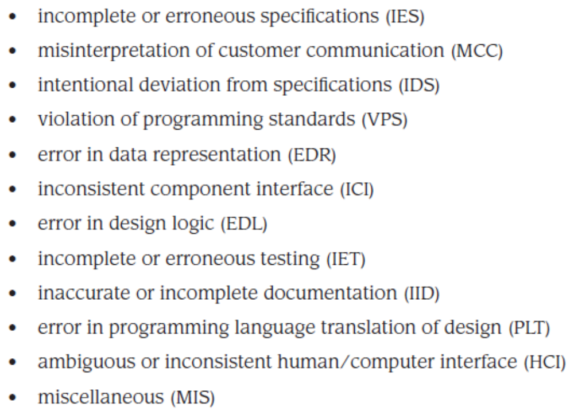
Although hundreds of different errors are uncovered, all can be tracked to one (or more) of the following causes:

Slide 4
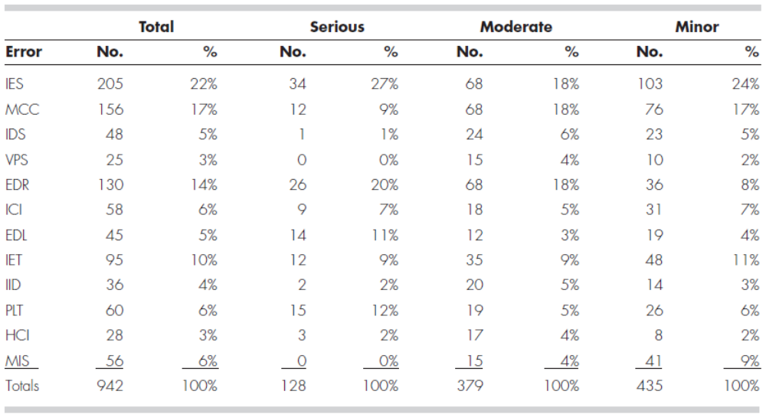
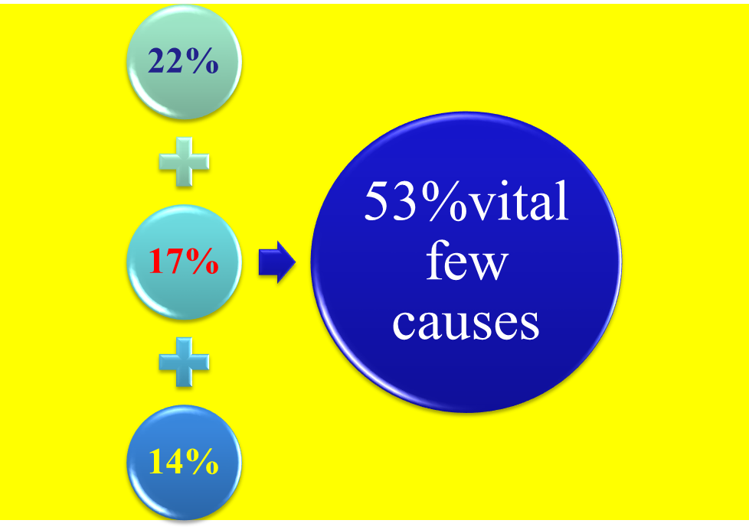
To apply statistical SQA, A Table of error is built.
DATA COLLECTION FOR STATISTICAL SQA

Slide 5
It is important to note that corrective action focuses primarily on the vital few. As the vital few causes are corrected, new candidates pop to the top of the stack.

Slide 6
In conjunction with the collection of defect information, software developers can calculate an error index (EI) for each major step in the software process . After analysis, design, coding, testing, and release, the following data are gathered:
Ei = the total number of errors uncovered during the ith step in the software engineering process.
Si = the number of serious errors
Mi = the number of moderate errors
Ti = the number of minor errors
PS = size of the product (LOC, design statements, pages of documentation) at the ith step

Slide 7
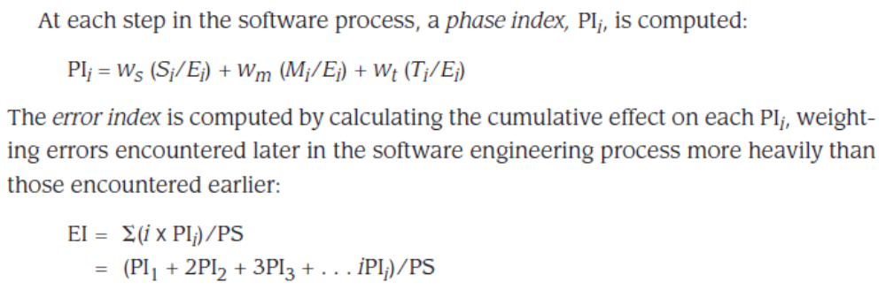
ws, wm, wt = weighting factors for serious, moderate, and trivial errors, where recommended values are ws = 10, wm = 3, wt = 1.
The error index can be used in conjunction with information collected in Table to develop an overall indication of improvement in software quality.

Slide 8
SOFTWARE RELIABILITY
There is no doubt that the reliability of a computer program is an important element of its overall quality. If a program repeatedly and frequently fails to perform, it matters little whether other software quality factors are acceptable.
Software reliability is defined in statistical terms as "the probability of failure-free operation of a computer program in a specified environment for a specified time" [MUS87].
Whenever software reliability is discussed, a pivotal question arises: What is meant by the term failure? In the context of any discussion of software quality and reliability, failure is nonconformance to software requirements.

Slide 9
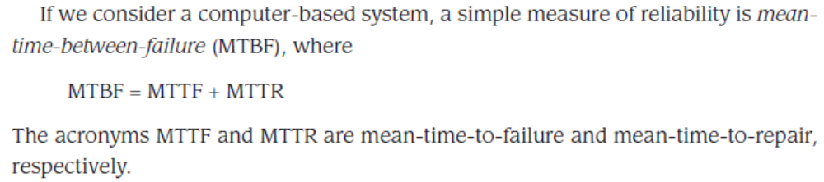
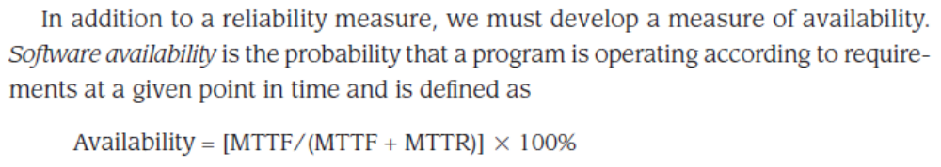
Measures of Reliability and Availability

Slide 10
Software Safety
Defined as a software quality assurance activity that focuses on identifying potential hazards that may cause a software system to fail.
Early identification of software hazards allows developers to specify design features to can eliminate or at least control the impact of potential hazards.
Software reliability involves determining the likelihood that a failure will occur, while software safety examines the ways in which failures may result in conditions that can lead to a mishap.

Slide 11
Mistake-Proofing Software
Poka-yoke devices are mechanisms that lead to the prevention of a potential quality problem before it occurs or to the rapid detection of a quality problem if one is introduced
Poka-yoke devices are simple, cheap, part of the engineering process, and are located near the process task where the mistakes occur

Slide 12
ISO Quality Standards
Quality assurance systems are defined as the organizational structure, responsibilities, procedures, processes, and resources for implementing quality management.
ISO 9000 describes the quality elements that must be present for a quality assurance system to be compliant with the standard, but it does not describe how an organization should implement these elements.
ISO 9001 is the quality standard that contains 20 requirements that must be present in an effective software quality assurance system.

Slide 13
SQA Plan
Management section - describes the place of SQA in the structure of the organization
Documentation section - describes each work product produced as part of the software process
Standards, practices, and conventions section - lists all applicable standards/practices applied during the software process and any metrics to be collected as part of the software engineering work
Reviews and audits section - provides an overview of the approach used in the reviews and audits to be conducted during the project
Test section - references the test plan and procedure document and defines test record keeping requirements
Problem reporting and corrective action section - defines procedures for reporting, tracking, and resolving errors or defects, identifies organizational responsibilities for these activities
Other - tools, SQA methods, change control, record keeping, training, and risk management

